Slide 1

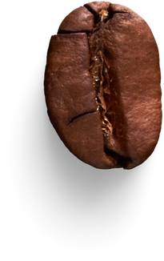



SAVORING NEW HORIZONS:
CONG CA PHE'S
UK EXPANSION

Slide 2

1.
Contents
Company Analysis
2.
Macro-environment Analysis of UK market
3.
Out-of-home Coffee Industry Analysis
4.
Strategic recommendations to enter UK market

Slide 3

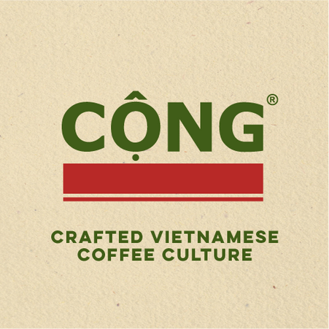

Company Analysis

Slide 4
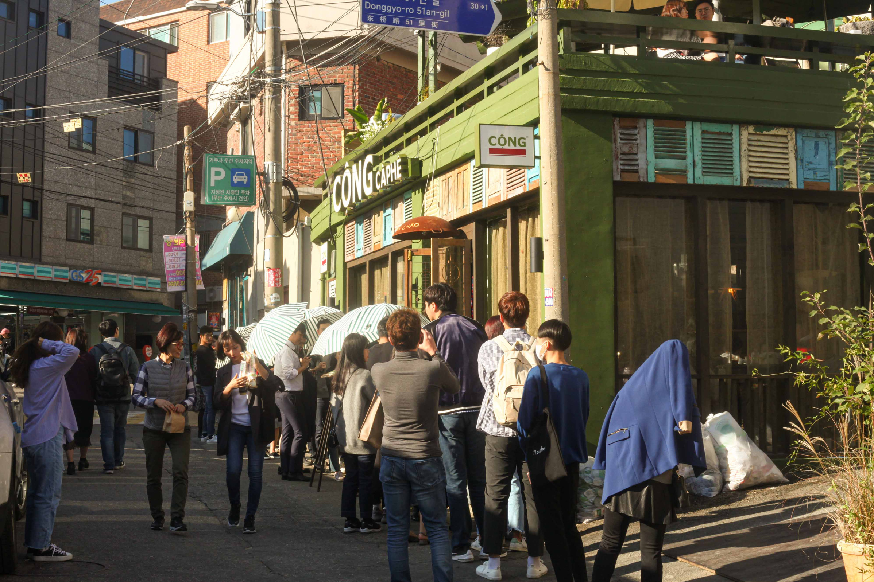
Company Overview
Business model: Vietnamese Coffee Chain
Employees: 201-500 employees (Linkedin 2025)
International Presence:
Vietnam
South Korea
Malaysia
Canada
Taiwan
Product Offerings: Traditional Vietnamese coffee, unique beverages, and authentic snacks inspired by Vietnamese culture (Cong Ca Phe 2025).
Target Customers
Local Vietnamese coffee enthusiasts
International customers seeking authentic Vietnamese experiences
Young adults and families looking for cozy, social environments

Slide 5

Target customers in foreign markets
Locations: Large bustling cities (Busan, Toronto, Seoul) (Cong Ca Phe 2025)
Ages: 16-40
Customer:
Vietnamese abroad who seek a connection to the home country, particularly the subsidy period of Vietnam. Cong Ca Phe provides them with a nostalgic experience that resonates with their desire for authenticity and cultural connection (Nguyen 2023).
Young people open to new experience and taste who are drawn to brands that offer unique experiences and products. They are likely to appreciate Cong Ca Phe's distinctive Vietnamese coffee offerings and the cultural ambiance of the café, which sets it apart from mainstream coffee shops (Nguyen 2023).

Slide 6
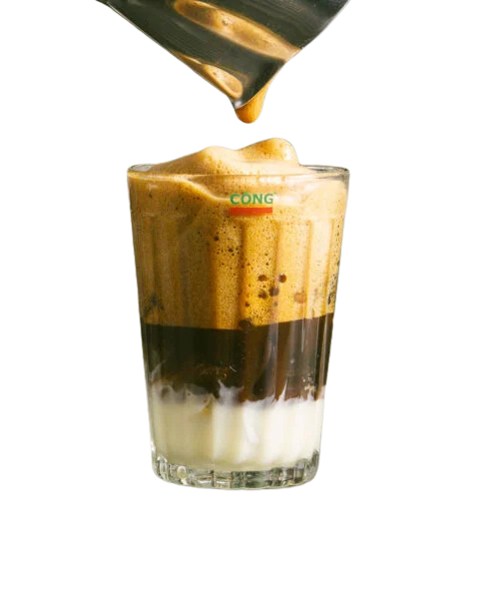
Competitive advantages
Strong Brand Identity
The café’s branding emphasizes its roots in Vietnamese culture, appealing to both locals and tourists interested in a genuine experience.
Authentic Vietnamese Offerings
Unique Menu: Cong Ca Phe specializes in traditional Vietnamese coffee, including signature drinks like egg coffee and coconut coffee, which are not commonly found in mainstream coffee shops.
Cultural Ambiance
The café’s decor reflects Vietnamese culture, creating a warm and welcoming environment that attracts customers.
High-Quality Ingredients
Community Hub
The café focuses on sourcing high-quality coffee beans and fresh ingredients, ensuring superior taste and freshness.
The ambiance encourages social interaction, making it a popular gathering place.

Slide 7

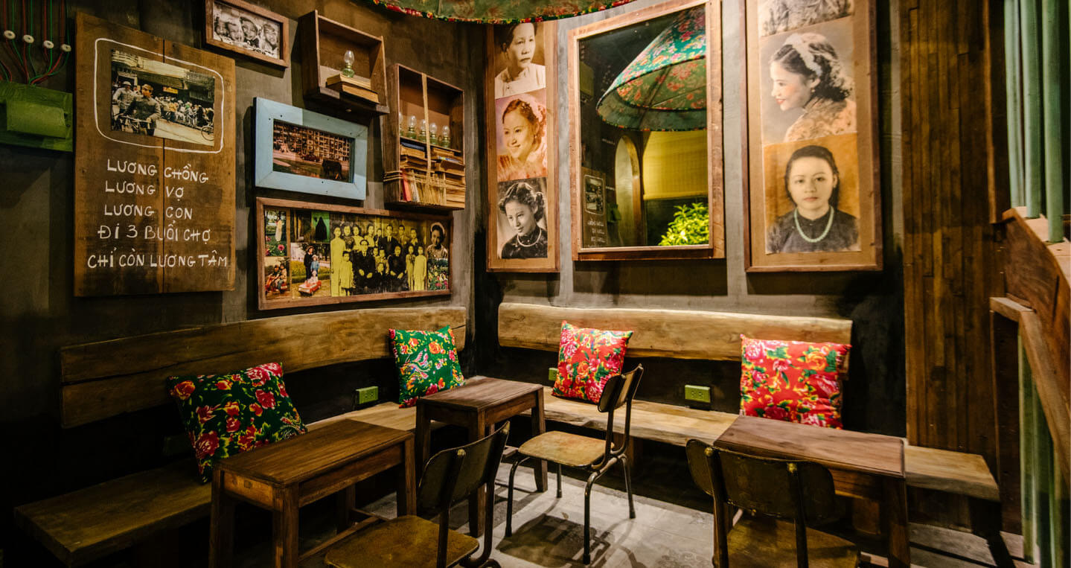

A focused differentiation strategy
Cong Ca Phe employs a focused differentiation strategy in foreign markets. By offering unique Vietnamese coffee experiences and authentic flavors that cater specifically to local tastes, the café distinguishes itself from mainstream coffee chains.
This approach allows Cong Ca Phe to attract a niche market that appreciates the cultural authenticity and quality of its products while creating a strong brand identity in diverse, multicultural environments.

Slide 8
Macro-environment Analysis of UK market
(PESTEL Analysis)

Slide 9
Political Factors
Pestel Framework (Witcher& Chau 2010)
Opportunities
Threats
Government Incentives: The UK government provides various incentives for small and medium-sized enterprises (SMEs), such as:
Tax breaks (Seed Enterprise Investment Scheme (GOV n.d.b), Enterprise Investment Scheme (EIS), Entrepreneur's Relief (GOV n.d.a))
Funding schemes (Boiler Upgrade Scheme, Workplace Charging Scheme, Cycle to Work Scheme)
Industry Promotion Policies: The UK’s endorsement of the International Coffee Agreement 2022 emphasizes sustainability within the coffee sector (British Coffee Association 2023).
Trade Agreements Supporting Imports: The UK-Vietnam Free Trade Agreement (UKVFTA) reduces tariffs on Vietnamese goods, including coffee and other ingredients (Great Britain 2024). This means that Cong Cafe franchises will benefit from lower import costs, allowing them to offer authentic Vietnamese products at competitive prices.
Complex Immigration Laws: Stricter immigration policies may hinder the hiring of Vietnamese staff or chefs due to visa challenges.
Political Instability: Changes in government or political leadership can lead to shifts in business policies. A more protectionist government might implement policies that are unfavorable to foreign franchises, impacting Cong Cafe's ability to operate smoothly.

Slide 10
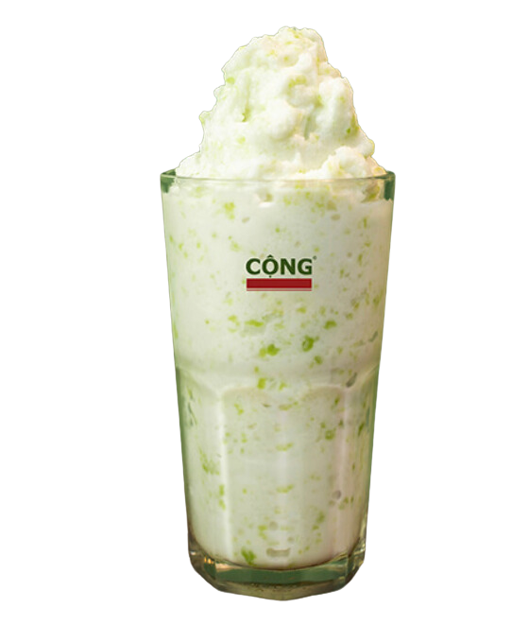
Economic Factors
Pestel Framework (Witcher& Chau 2010)
Opportunities
Threats
Strong Coffee Culture Economy: The UK coffee shop market is valued at over £10 billion (2024) and is projected to grow to £12.9 billion by 2029 (Mintel 2024).
Collaborations and Partnerships: Partnering with local businesses, such as bakeries, can enhance Cong Ca Phe's menu and attract customers (Mintel 2024).
Increasing Disposable Income: Real households' disposable income grew by 1.3% in Q2 2023, allowing Cộng Cà Phê to position itself as a premium café experience (ONS 2024).
Urban Growth: The UK’s urban population grew by 1.11% in 2023 according toWorld Bank (see Trading Economics 2025), providing diverse customer bases and high foot traffic.
Tourism Appeal: In 2023, 38 million overseas visitors spent £31.1 billion in the UK, making Cộng Cà Phê’s unique aesthetic appealing to tourists seeking authentic experiences (ONS 2023).
Operational Costs: Rents in the UK have been rising faster than wages for nearly two years (BBC News 2024).
Interest Rate Increases: The Bank of England has raised interest rates since 2021 to combat inflation, leading to higher borrowing costs for franchisees (Bank of England 2024). This may deter investment in Cong Ca Phe and limit expansion opportunities.

Slide 11

Social Factors
Pestel Framework (Witcher& Chau 2010)
Opportunities
Threats
Diverse Consumer Base: The multicultural landscape in the UK (Ashcroft & Bevir 2017) offers a chance to introduce Vietnamese coffee culture, appealing to consumers interested in global cuisines.
Rising Interest in Specialty Coffee: Demand for unique coffee experiences is rising, aligning with Cong Ca Phe’s offerings like coconut coffee. 32% of coffee buyers prefer venues with diverse options (Mintel 2024). Half of coffee shop customers are interested in international drinks like Vietnamese coffee or Taiwanese bubble tea, increasing to 71% among those aged 16-34, who are more inclined toward unique options (Mintel 2024).
Sustainable Collaborations: Partnering with sustainable brands may appeal to 56% of coffee drinkers interested in brand partnerships, especially 74% of those aged 16-34 (Mintel 2024).
Health-concious Older Demographics: Catering to the over-55 population, who prioritize healthy eating, could enhance appeal and profitability (Mintel 2024).
Demographic Sensitivities: Pricing strategies must consider affordability for younger consumers, a key demographic in coffee purchasing.
Rise in Decaffeinated Coffee: Increased consumption of decaffeinated coffee is expected in 2024 (Mintel 2024).

Slide 12

Legal Factors
Pestel Framework (Witcher& Chau 2010)
Opportunities
Threats
Transparent Legal Systems: The UK's legal framework includes regulations on food safety, employment, and contracts, such as the Food Standards Act 1999 and Food Information Regulations 2014 (Food Standards Agency 2020).
Trademark Protection: The Trade Marks Act 1994 allows Cong Ca Phe to register its brand name and logo with the UK Intellectual Property Office, safeguarding its identity and enabling legal action
Corporation Tax Compliance: The current corporation tax rate in the UK is 25% for profits over £250,000 (GOV n.d.c). Cong Cafe will need to implement tax planning strategies to optimize its tax liabilities and ensure timely compliance with corporation tax filings.
Complexity of VAT Rates: The UK has multiple VAT rates, including standard (20%), reduced, and zero-rated (GOV n.d. d).
Labor Laws: Compliance with minimum wage laws and working hour restrictions may increase operational costs.

Slide 13
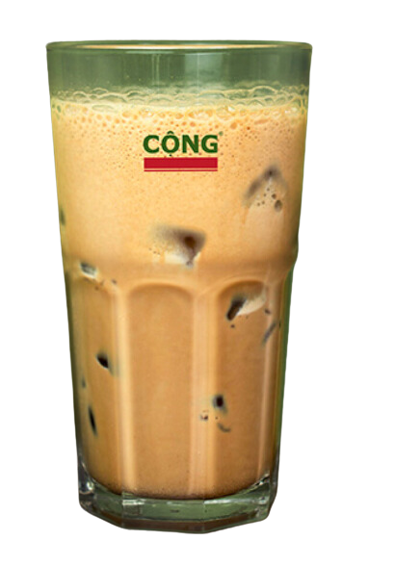
Technological Factors
Pestel Framework (Witcher& Chau 2010)
Opportunities
Threats
Digital Platforms: The popularity of food delivery services such as Deliveroo and Uber Eats provides an avenue for reaching a broader audience, especially in urban areas.
Generative AI: Generative AI is now a valuable member of the team, serving as a strategic partner for social media strategists. (Hootsuite 2025).
Augmented Reality Experiences: Exploring the use of augmented reality (AR) for promotional campaigns
Technology Adaptation Costs: Continuous investment in advanced point-of-sale (POS) systems, digital marketing, and app integration may strain initial budgets.
Tech-Driven Competition: Competitors using AI-driven customer insights or advanced online ordering systems may gain an edge.

Slide 14

Pestel Framework (Witcher& Chau 2010)
Environmental Factors
Opportunities
Threats
Sustainability Trends: UK consumers increasingly demand eco-friendly practices. Cộng Cà Phê can capitalize on this by promoting sustainable ingredient sourcing and reducing single-use plastics (Mintel 2024).
Product Development: Advancements in sustainable sourcing and a focus on health through new product development—like incorporating natural ingredients, vitamins, and expanding decaf options—can attract a broader audience (Mintel 2024).
Green Certifications: Obtaining certifications for sustainable practices could appeal to environmentally conscious customers.
Regulatory Pressure: The UK government’s focus on reducing carbon emissions may require investments in greener operations, such as renewable energy sources and waste management (GOV n.d.e).

Slide 15
Out-of-home Coffee
Industry Analysis

Slide 16
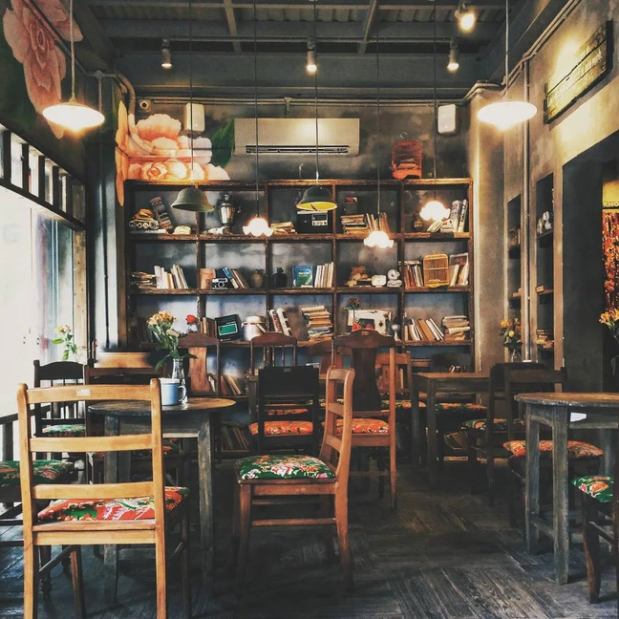
Porter’s 5 Forces Framework (Porter 1980)
Threat of New Entrants: High
Low Barriers to Entry: Major costs in the UK café industry include wages (25.3%), purchases (44.1%), and rent/utilities (7.7%) (IBISWorld 2024), with relatively low initial capital requirements.
Absence of Network Effects: The café business lacks network effects, enabling easy competition for new entrants
Brand Loyalty: Established chains like Starbucks and Costa have strong brand loyalty, which can deter new entrants. 71% of customers who claimed a birthday cake at Costa returned within a month (Parr 2022)
Low Switching Costs: Customers can easily switch cafés, especially in urban areas, making it easier for new entrants to attract customers from established brands.

Slide 17
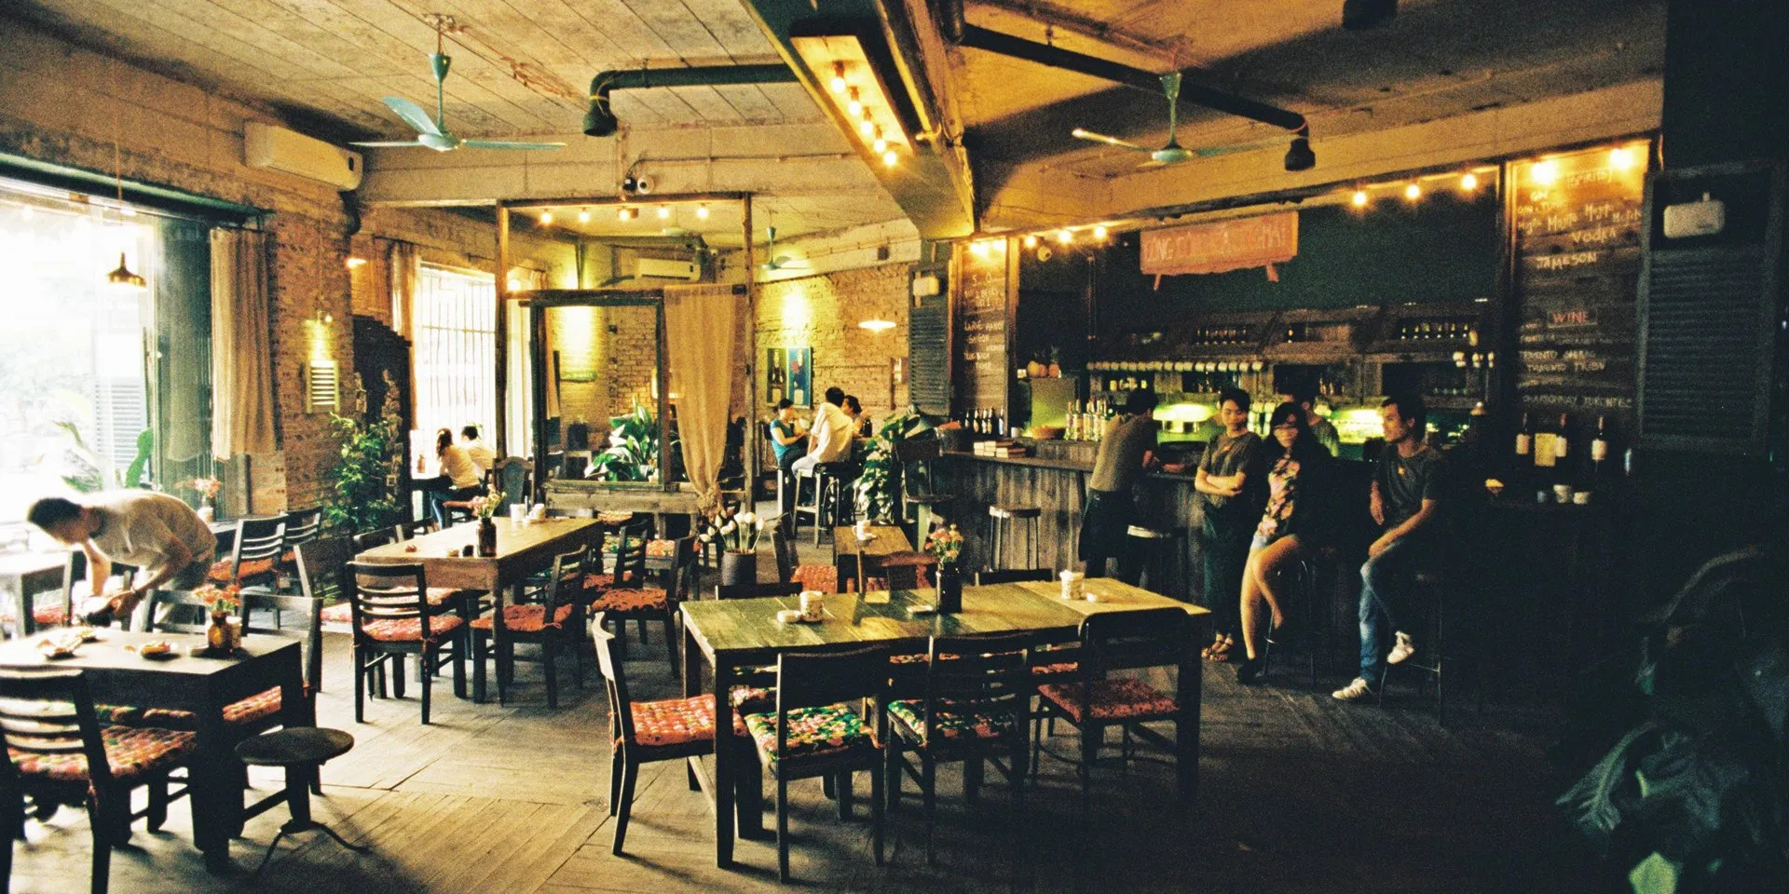
Bargaining Power of Suppliers: Low
Supplier Concentration: In 2024, Vietnam is the second-largest coffee supplier to the UK (Vietnamnews 2024). The UK boasts more than 650 coffee roasters of varying sizes and expertise, resulting in a competitive supplier landscape (Bellis 2024).
Unique Ingredients: If Cộng Cà Phê uses specific Vietnamese coffee or unique ingredients, supplier power may slightly increase, particularly if those suppliers are limited.
Switching Costs: While switching suppliers can involve costs due to specific contracts or quality standards, these are generally manageable, keeping supplier power relatively low.
Porter’s 5 Forces Framework (Porter 1980)

Slide 18

Bargaining Power of Buyers : High
Consumer Choice: The UK market has a plethora of coffee shops, giving consumers a wide range of options. This high level of choice increases buyer power.
Price Sensitivity: While some consumers are willing to pay a premium for specialty coffee, others are more price-sensitive, especially during economic downturns.
Brand Loyalty: Established brands may have loyal customers, but there’s also a growing trend towards unique and independent cafes, which Cộng Cà Phê could leverage.
Porter’s 5 Forces Framework (Porter 1980)

Slide 19
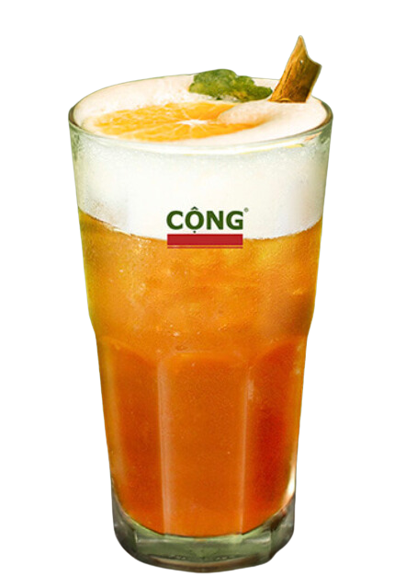
Porter’s 5 Forces Framework (Porter 1980)
Threat of Substitute Products: Moderate
Alternative Beverages: Consumers can easily switch to alternatives like tea or decaffeinated coffee; 63% of survey respondents regularly consume both (Statista 2021). These options cater to diverse preferences while providing viable substitutes for Vietnamese coffee.
Low switching costs in coffee due to low prices, abundant options, and numerous cafés enable easy brand transitions without loyalty constraints.
Differentiation through Experience: Cộng Cà Phê’s unique ambiance, shaped by retro Vietnamese decor, offers a distinctive experience that is difficult to replicate, reducing substitution likelihood.

Slide 20
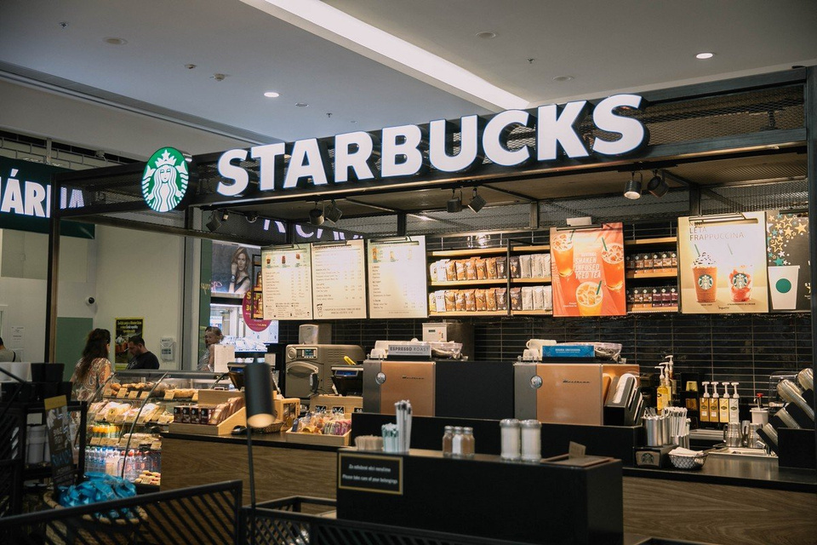
Porter’s 5 Forces Framework (Porter 1980)
Threat of Industry Rivalry : Moderate-High
Number of Competitors: There are 8,172 cafés and coffee shops in the UK (IBISWorld 2024), with the top three brands (Costa, Starbucks, Pret a Manger) holding 51.7% of the market, intensifying rivalry (Mintel 2024)
Industry Growth Rate: The market value rose to £9.7bn in 2023 and is projected to grow by 4% in 2024, indicating stable growth post-pandemic (Mintel 2024).
Low Fixed Costs: This flexibility allows competitors to operate with lower margins, increasing price competition.
Strategic Stakes of Rivals: Competing against large corporations can heighten rivalry due to their greater resources for marketing and innovation.
Product Differentiation: Cộng Cà Phê's unique Vietnamese coffee and cultural experience help mitigate competitive pressures and attract loyal customers, allowing for better pricing power.

Slide 21
Strategic recommendations
to enter UK market

Slide 22
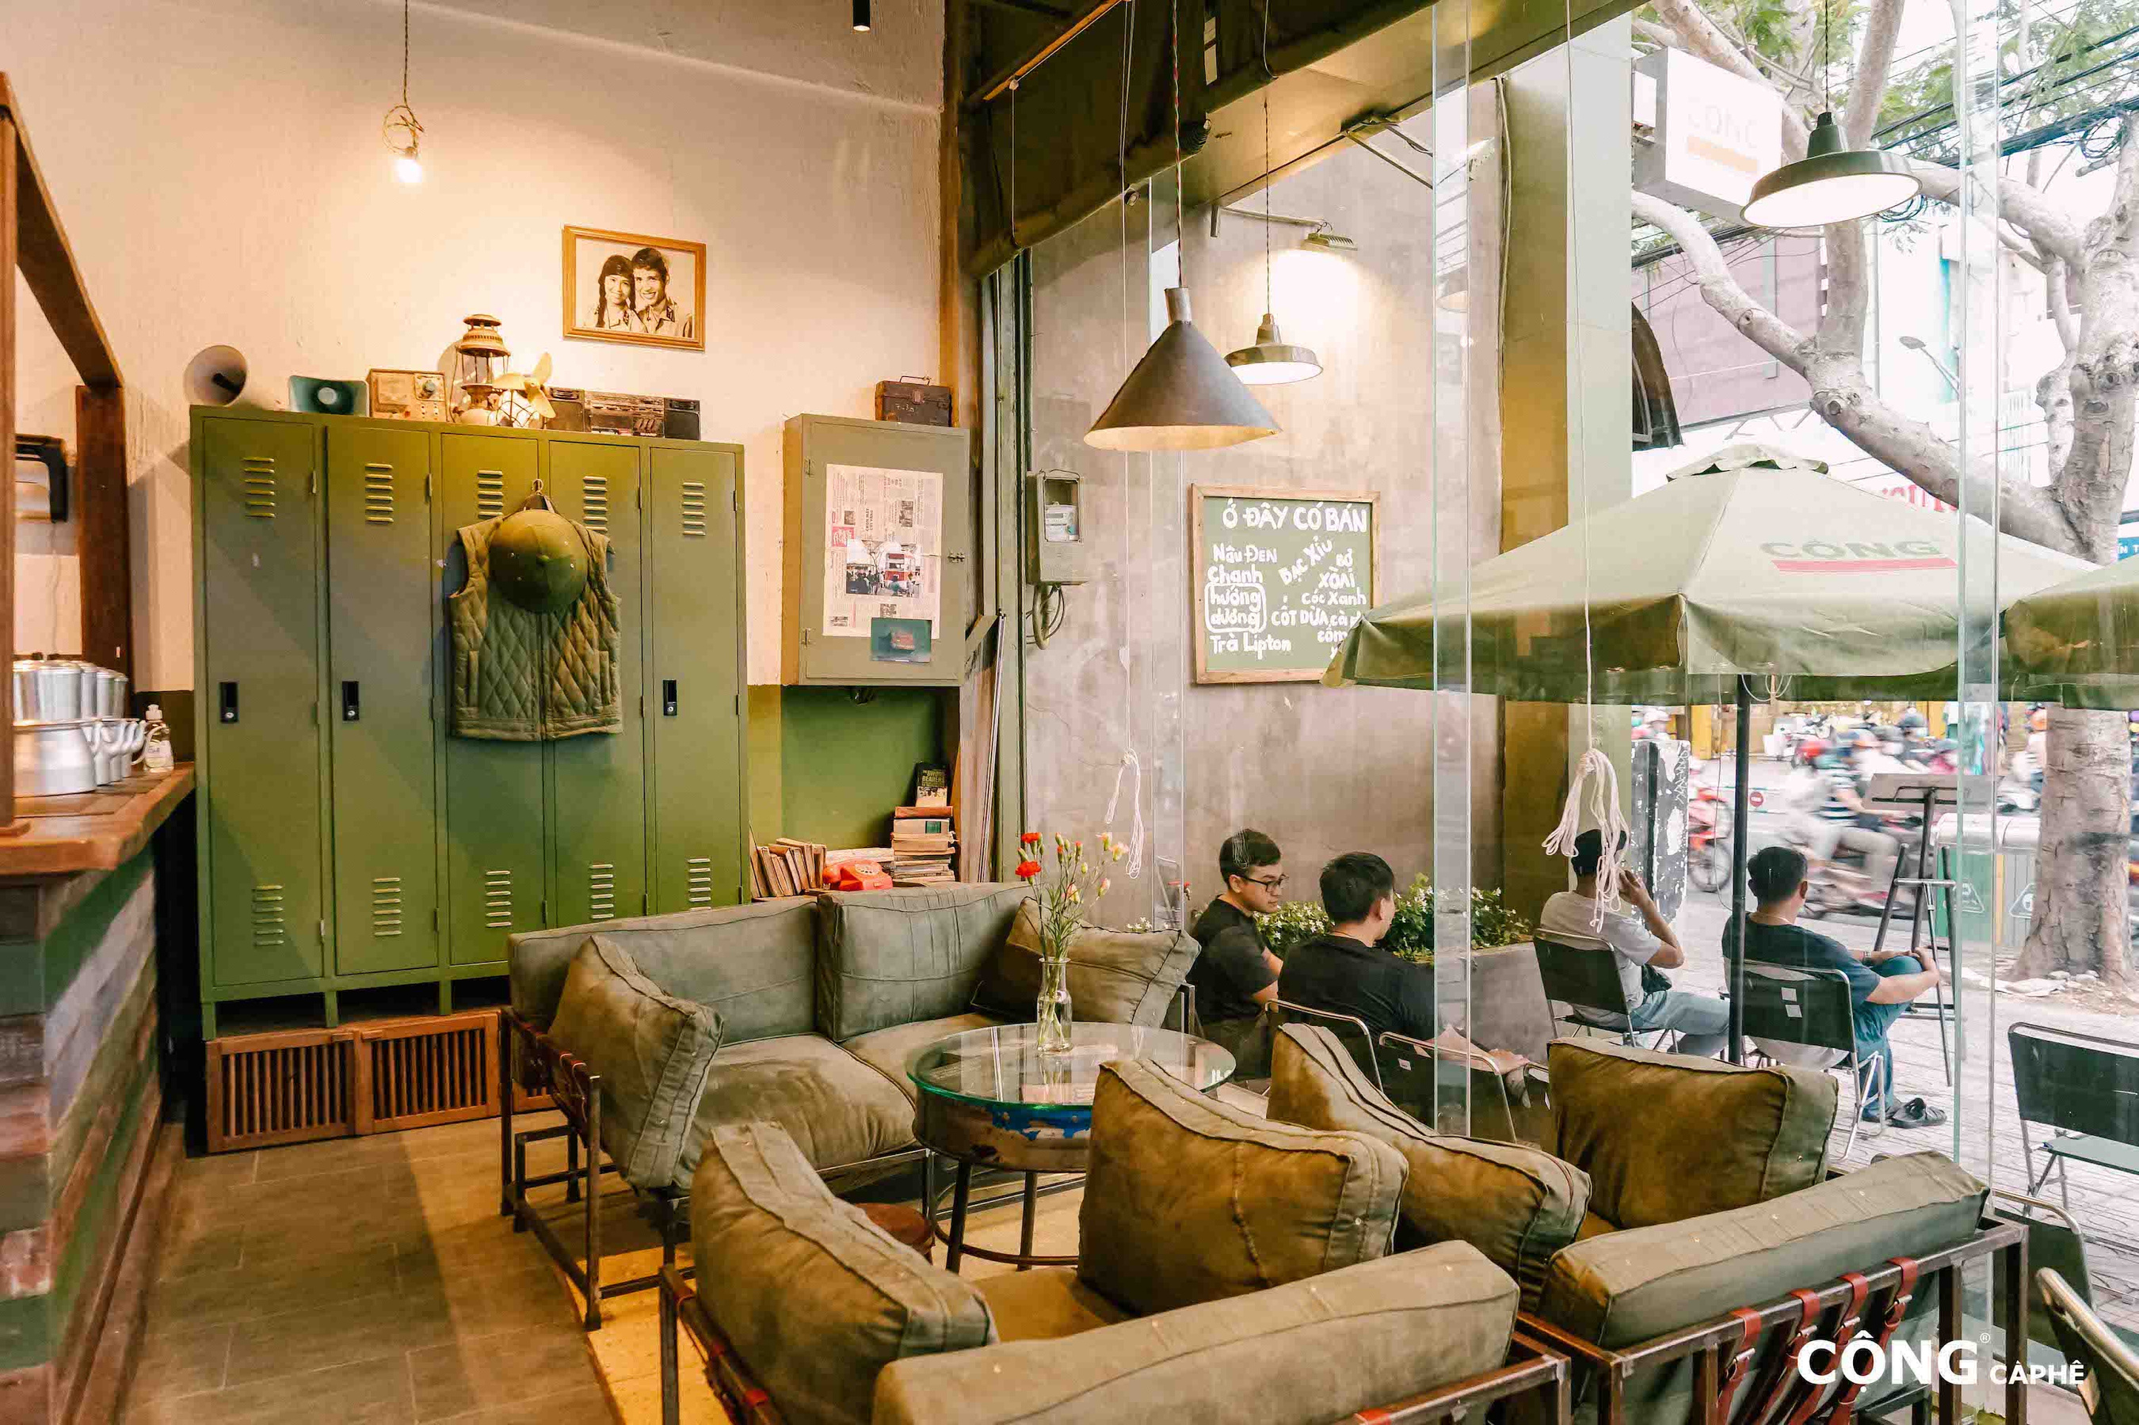
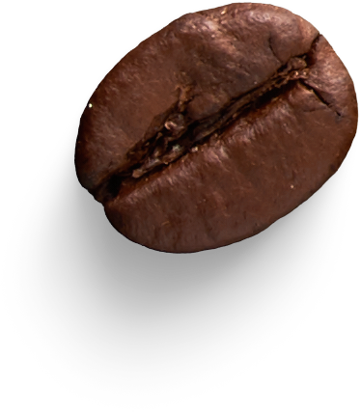

Entry mode: Franchising
Less Viable to Export: Cộng Cà Phê's focus on hand-brewed Vietnamese coffee and in-store experiences makes export less feasible.
Proven Success: The franchise model has thrived in Korea, Malaysia, Taiwan, and Canada, suggesting a good chance of success in the UK.
Lower Capital Investment: Franchisees manage setup and operations, reducing capital needs for Cộng Cà Phê in a competitive market.
Local Market Knowledge: Franchisees offer valuable insights into local preferences.
Rapid Expansion: The franchising model enables quick market penetration, allowing multiple locations to open simultaneously and build brand recognition rapidly.
Shared risks

Slide 23
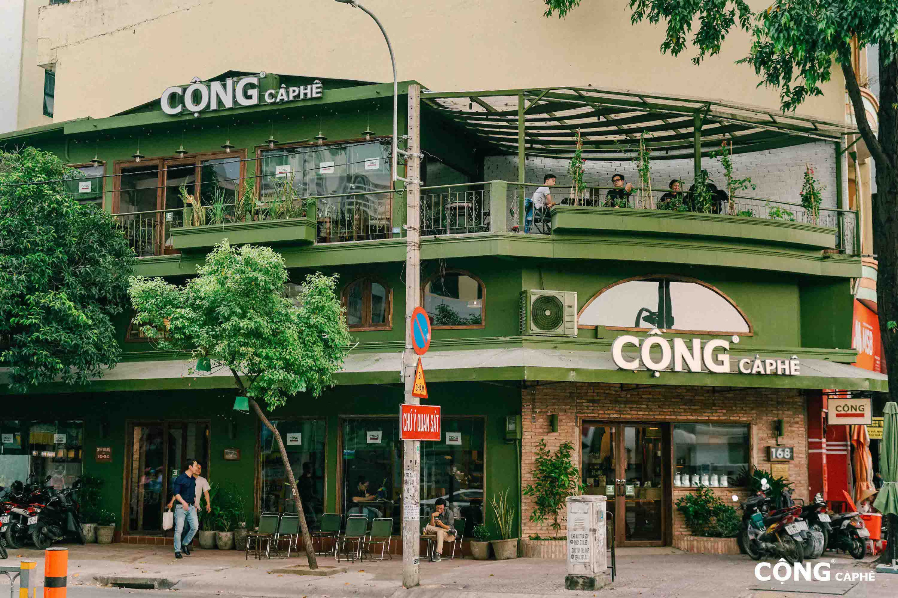
Product, Goals, and Mission
Alignment
Product Alignment: The franchising model enables replication of the authentic coffee experience while allowing local adaptations to regional tastes.
Goals and Mission: Cộng Cà Phê aims to deliver an authentic Vietnamese coffee experience and promote Vietnamese culture (Cong Ca Phe 2025). The goal of expanding market share in the UK aligns with franchising, facilitating rapid growth and increased brand visibility without overextending resources.
Current Strategic Positioning: The franchising model differentiates Cộng Cà Phê from established competitors by emphasizing its cultural heritage and authentic offerings.

Slide 24
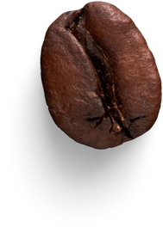
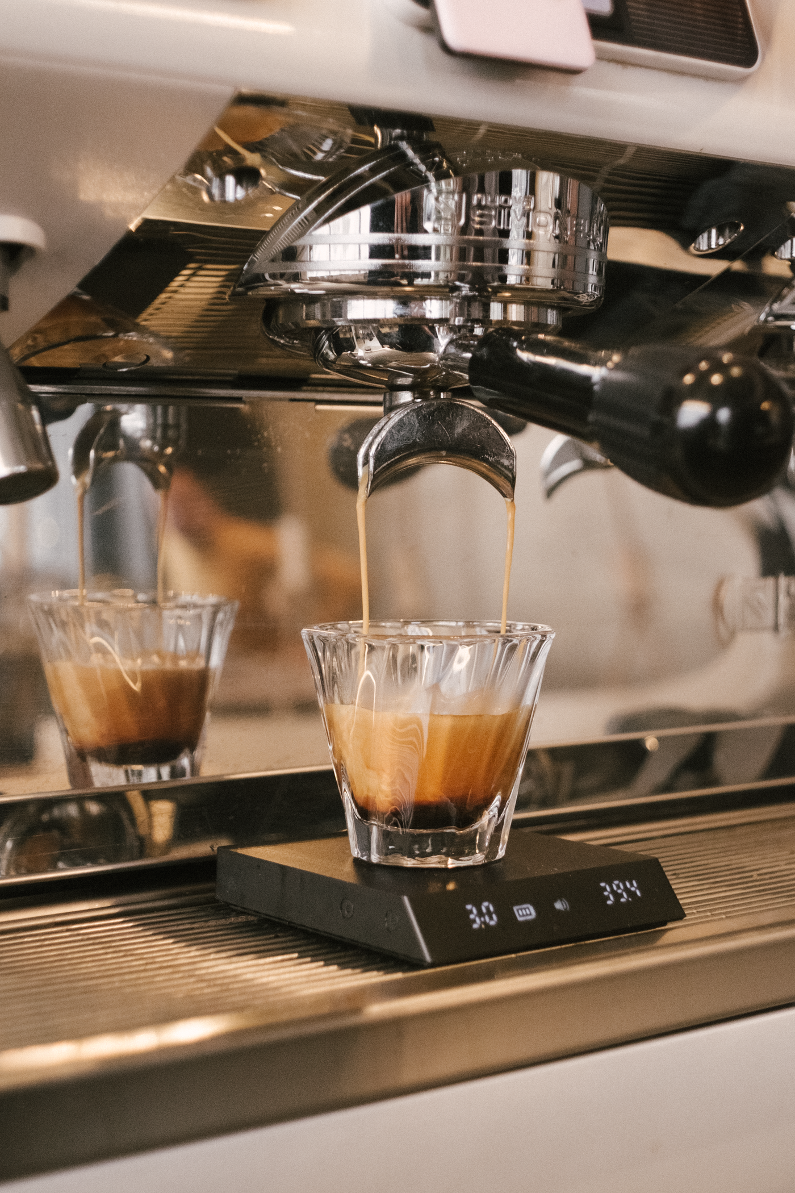

Action plan
Phase 1: Market Research and Feasibility Study
Identify target demographics and potential franchise locations.
Analyze UK franchising regulations and coffee industry requirements.
Phase 2: Develop Franchise Model
Create a Franchise Business Plan.
Develop training programs and standardize operations manual.
Phase 3: Legal and Financial Preparation
Consult legal experts to draft compliant franchise agreements.
Ensure branding and recipe protections are in place.
Explore financing options for franchisees with banks or financial institutions.
Phase 4: Recruit Franchisees
Launch a recruitment campaign and attend franchise expos to attract potential franchisees.
Phase 5: Launch and Operations
Pilot a franchise location and evaluate for adjustments.

Slide 25
Thank you!

